Slide 1
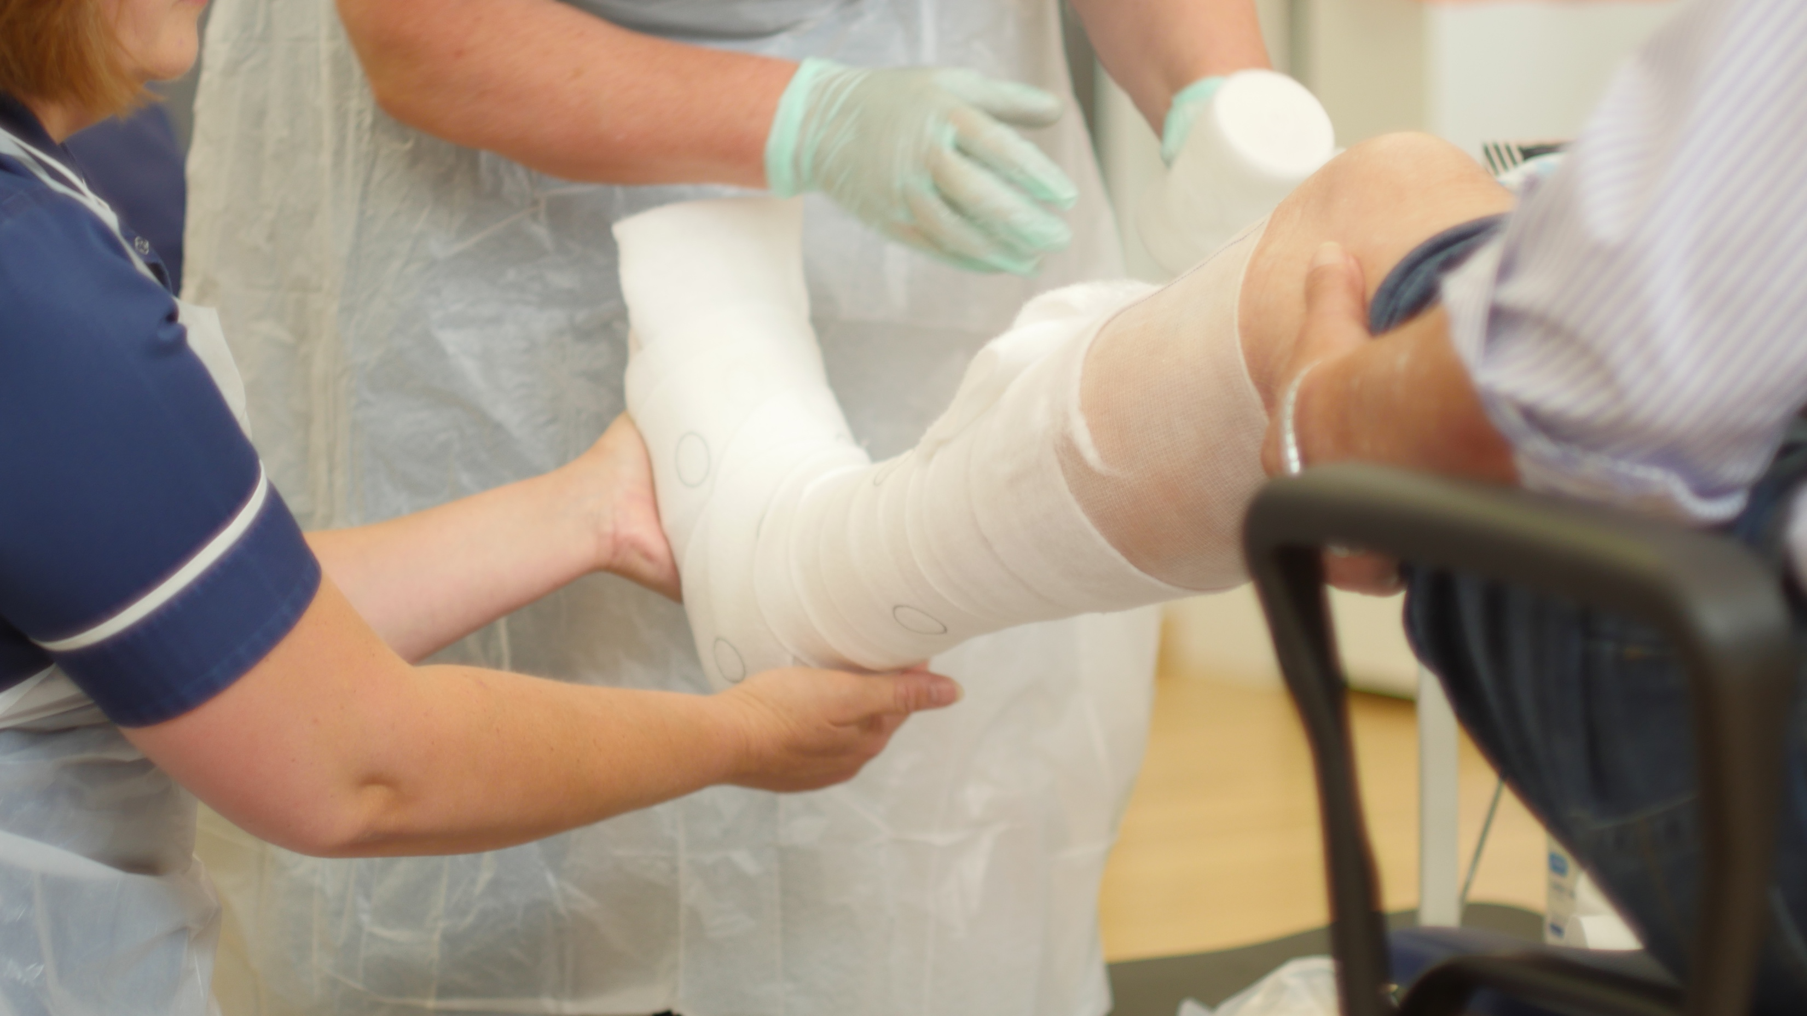
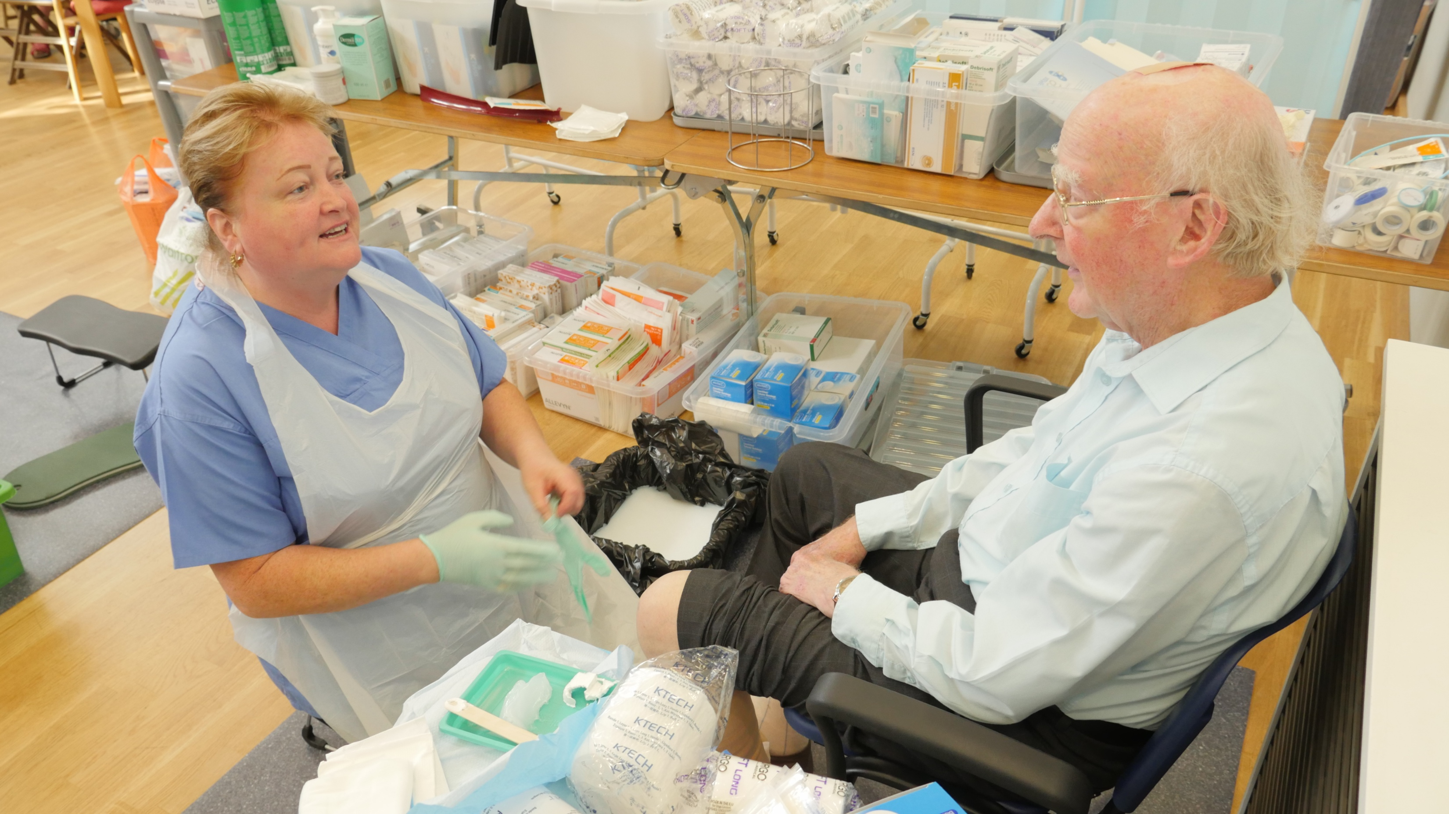
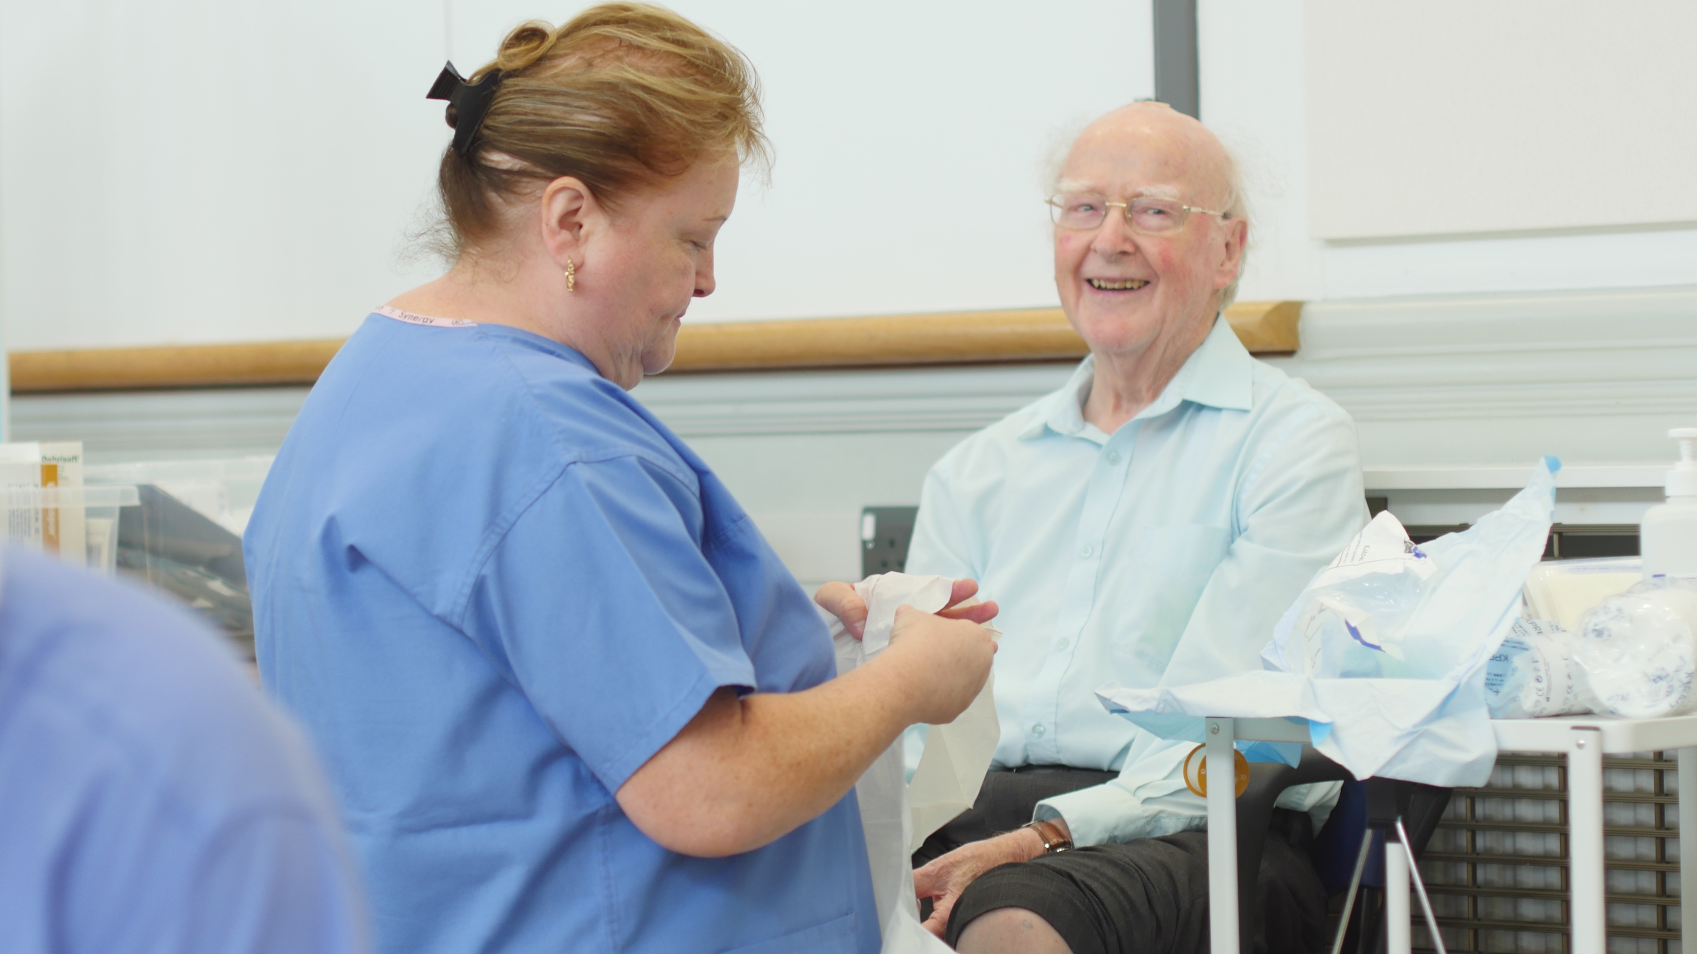
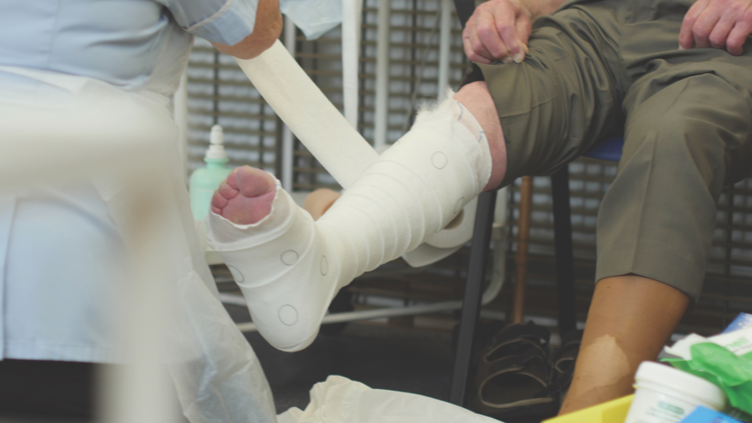
Cost-effectiveness of the Lindsay Leg Club model of care for people suffering from problems of the lower limb and leg ulceration Ellie Lindsay, OBE FQNI, Visiting Fellow, Queensland University of Technology and Joan-Enric Torra PhD, University of Lleida, Spain
A major demographic shift is unfolding and scientific and medical advances, population growth and change in societal age, compounded by a global shortage of nurses, will have an impact on lower limb management in the future.
The UK’s National Health Service (NHS) managed an estimated 2⋅2 million patients with a wound during 2012/2013, equivalent to 4⋅5% of the adult population. The annual cost to the NHS attributable to wound management and associated comorbidities was estimated at £5.3 billion (Guest et al, 2015)
Chronic wounds are usually a sign of wider systemic disease, which adds to the complexity of the process and challenges the priorities of treatment. The multidisciplinary nature of wound care compounds that problem further, often making it hard to identify the correct specialist to manage a person’s individual treatment journey.
The psychosocial economic Leg Club model of lower limb care provides a fixed weekly time and venue for treatment. That provides considerable time savings for practice and district nurses, who can schedule their workload in a more effective way and avoid unnecessary surgery and home visits.
Background
A major challenge in a world where populations are ageing is in finding meaningful ways for people to experience good quality of life while continuing to participate in and contribute to society. We understand the human and financial costs of living longer, and the increased likelihood of living with one or more chronic diseases. Of those diseases, chronic wounds often go unnoticed, but they represent a significant burden to individuals and global healthcare systems.
With a financial cost to the UK’s NHS of almost £5.3 billion annually the individual costs are also considerable. Those costs include the social stigma, pain and uncertainty attached to problems of the lower limb and leg ulceration. Leg ulcers are a major subset of chronic wounds and frequently lead to clinical depression, social isolation, a marked deterioration in overall quality of life and poor clinical outcomes. Many individuals have lived with open wounds for many years. They have been through endless cycles of healing and breakdown, with each cycle lasting many weeks or months. Those factors can contribute to depression, loss of esteem and self-neglect.
Method
With the increased exposure of the Leg Club model comes the greater need to demonstrate its effectiveness. The Foundation is now focusing on producing evidence in outcomes, recurrence and cost-effectiveness.
One of the Foundation’s key priorities is to reassure clinicians and demonstrate to them and their NHS provider how basic digital Leg Club information-sharing services can really transform lower limb health care in a positive way. To help ensure the implementation is successful and how best to get value from the Leg Club data system a training process is currently underway with the clinical and volunteer teams. Also, along with a data visual element process flow diagram and process charts, the revamped Leg Club eLearning package now has a link to the data training.
A trial was undertaken at Thetford Leg Club to debug and refine the process. In response to user feedback, efficiency and quality of results was undertaken with the next phase of automatic error checking for data introduced and manually entered into a database.
Results
Since the inception of the Leg Clubs there have been two priorities in the research arena. The first is that documentation should always be completed, which has in fact been the case. The second is that effectiveness should be examined in terms of not only clinical outcomes but also member (patient) satisfaction, quality of life, wellbeing and cost-effectiveness.
The majority of healed ulcers within the Leg Club network achieve healing within 2 months. At the beginning of 2014, the Leg Club network initiated a new outcomes data entry and reporting system. Wound progression was examined using accurate reports from the system pertaining to 3,124 members attending 10 Leg Clubs during the second half of 2015. During that period, 4,311 legs underwent treatment, with the remainder currently in the well leg (healed but continuously monitored phase). More recent reports from the top 20 Leg Clubs in the period 1st October 2016 to 31st March 2017 (exceeding half of all members in the network) confirmed that 64% of all healed ulcers achieved healing within 12 weeks.
Recent research demonstrating high levels of satisfaction with nursing staff is very encouraging. It hopefully demonstrates that the nursing care that members receive is at least as high as it would be in a traditional clinical environment, and that that is recognised by those receiving the care. There is more research to be done. The final validation of the outcomes database set up by the Leg Club Foundation, including the integrity of the data entered by individual Leg Clubs, is yet to be achieved. However, the conclusions have been taken from Leg Clubs whose data have been examined and verified.
Discussion
The field of wound management raises some interesting questions about modern society, the way that western health care is currently delivered and to what extent a reliance on our medical model of care alone can be sustained. In some ways the huge advances in medical science have made us victims of their success, as they have occurred during a period of great social change where the emphasis on the extended family for providing long-term holistic care has been replaced by a reliance on the State and the clinical services that it provides.
A ‘model of care’ broadly defines the way that health services are delivered. The medical model, which prevails today, is one that is focused on the diagnosis and treatment of disease. A social model of care attempts to address the broader influences on health. Its focus is on social, cultural, environmental and economic factors as opposed to just disease and injury.
Building an evidence base is one of the key priorities for the Leg Club model as that demonstrates to the clinician and NHS provider how basic digital information-sharing can provide evidence and bring change within a Leg Club. Currently, we are now starting to obtain good evidence since the introduction of digital technology within the Leg Club network.
Social prescribing models of care have been shown to be effective in several complex therapeutic areas. The ethos of the social Leg Club Model is to encourage wellness rather than treat illness in all age groups. By encouraging people to be fully involved in their treatment provides real motivation to individuals who are living with chronic wounds and find the experience of visiting the Leg Club is wholly positive.
Conclusion
The economic model needs to be developed further. However, it seems likely that there are considerable savings to be made on four levels: nursing time; the opportunities for sharing resources; the opportunities for prevention of major adverse events as members are regularly observed; and, finally, the contributions made by the voluntary sector, taking considerable pressure off a challenged NHS. In each of those cases there is potential for further study.
The Leg Club model appears to be effective on several levels: we have seen that there is a comparatively low recurrence rate after 24 weeks, and also that the majority of healed ulcers achieve healing within 2 months. Nursing treatment and protocols in Leg Clubs are at least equal to the national standard. However, it is possibly the regularity of visits, subsequent weekly monitoring and social interaction that are making the important difference.
A review has been conducted by the Swansea Centre for Health Economics using national statistics and available data to estimate the change in resources and costs that would be incurred by the UK NHS if a Leg Club model of care were to be widely implemented (Cullen et al, 2018)
From research to date, we can conclude that the Leg Club model is a positive reflection of a social model of care, proven to be effective on several levels and, in the light of current demographic, social and economic conditions, more relevant than ever.
The Leg Club text and logo are registered trademarks in the UK

